Slide 1
Add Instruction

Slide 2
“Add” Instruction
Operation | rs | rt | rd | shamt | funct | # meaning
add | 3 | 5 | 2 | 0 | 32 | # $2 <- $3 + $5

Slide 3
“Addi” Instruction
Operation | rs | rt | imm | # meaning
addi $5,$3,6 | 3 | 5 | 6 | # $5 <- $3 + 6

Slide 4
Sign Extension

Slide 5
Putting Add & Addi Together
4
PC
Read Addr
Out Data
Inst.
Mem.
Inst

Slide 6
Load Operation
Operation | rs | rt | imm | # meaning
lw $5,8($3) | 3 | 5 | 8 | # $5 <- M[$3 + 8]
4
PC
Read Addr
Out Data
Inst
Mem

Slide 7
Store Operation
Operation | rs | rt | imm | # meaning
sw $5,8($3) | 3 | 5 | 8 | # M[$3 + 8] <- $5
4
PC
Read Addr
Out Data
Inst
Mem

Slide 10
Putting load/store together
4
PC
Read Addr
Out Data
Inst
Mem

Slide 11
“beq” Instruction
Operation
rs
rt
imm
# meaning
Beq $3,$5,lp
3
5
6
# if ($3 == $5) goto lp
4
PC
Read Addr
Out Data
Inst
Mem
op/fun
rs
rt
rd
imm

Slide 12
“j” Instruction
Operation
Target address
# meaning
J loop
0x0174837
# goto loop
4
PC
Read Addr
Out Data
Inst
Mem
op/fun
rs
rt
rd
imm

Slide 13
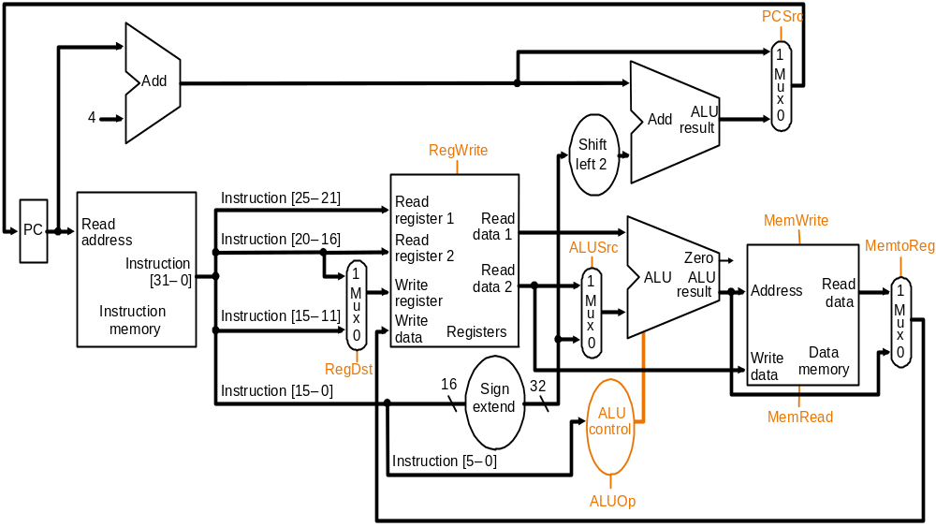
The single-cycle processor

